Slide 1
Capstone Project IV Unsupervised Machine Learning Book Recommendation System
By- Avinash Yadav Himanshu Tiwari
Sachin Pandey Deepika Yadav

Slide 2

Presentation Outline:
Problem statement
Data Summary
Data Pre-processing
EDA
Feature Engineering
Different Recommendation Model
Challenges
Conclusion

Slide 3

Problem Statement
During the last few decades, with the rise of YouTube,
Amazon, Netflix, and many other such web services,
recommender systems have become much more
important in our lives in terms of providing highly
personalized and relevant content.
Recommender systems are really critical in some
industries as they can generate a huge amount
of income when they are efficient or also be a
way to stand out significantly from competitors.
The main objective is to create a recommendation
system to recommend relevant books to users
based on popularity and user interests.

Slide 4
Data Summary
The dataset is comprised of three CSV files:
Users: Contains the users. Note that user IDs (User-ID) have been anonymized and map to integers. Demographic data is provided (Location, Age) if available. Otherwise, these fields contain NULL-values.
Books: Books are identified by their respective ISBN. Invalid ISBNs have already been removed from the dataset. Moreover, some content-based information is given (Book-Title, Book-Author, Year-Of-Publication, Publisher), obtained from Amazon Web Services. Note that in case of several authors, only the first is provided. URLs linking to cover images
Ratings: Contains the book rating information. Ratings (Book-Rating) are either explicit, expressed on a scale from 1-10 (higher values denoting higher appreciation), or implicit, expressed by 0.

Slide 5
Data Summary(Contd.)
Users_dataset:
● User-ID (unique for each user)
● Location (contains city, state and country separated by commas)
● Age
● Shape of Dataset - (278858, 3)
Books_dataset:
● ISBN (unique for each book) ● Image-URL-S
● Book-Title ● Image-URL-M
● Book-Author ● Image-URL-L
● Year-Of-Publication ● Shape of Dataset - (271360, 8)
● Publisher
Ratings_dataset:
● User-ID ● ISBN
● Book-Rating ● Shape of Dataset - (1149780, 3)

Slide 6
Data Pre-processing
Books Data pre-processing:
1. In books data pre-processing we handled missing values and duplicated values.
2. Handled outliers in Year-of-Publication column.
3. Corrected values in Book-Author, Book-Title and Publisher Column.
4. Dropped image-url-s, image-url-m and image-url-l columns as they were not of
much importance.
User Data pre-processing:
1. In user data pre-processing, we took the age group of 6 to 90.
2. Extracted city, state and country features from Location column.
3. Handled outliers, missing values and duplicated values in age columns.

Slide 7

Data Pre-processing(Contd.)
Rating Data pre-processing:
1. In rating data pre-processing, we separated book rating into rating implicit and rating explicit.
2. Handled outliers, missing values and duplicate values in book rating.

Slide 8

Exploratory Data Analysis

Slide 9
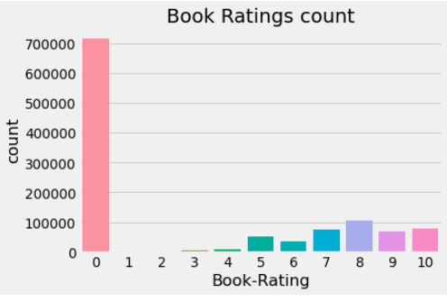
Analysis on: Book Rating Counts
Here we can see that the rating 0
Eithershows the users did not read or rated the books.
It shows that the most of the
people either didn't rate or read the books.
However 8 has been rated second
highest after 0.
So it would be rather better if we drop this 0 rating and do the
further analysis on the columns.

Slide 10
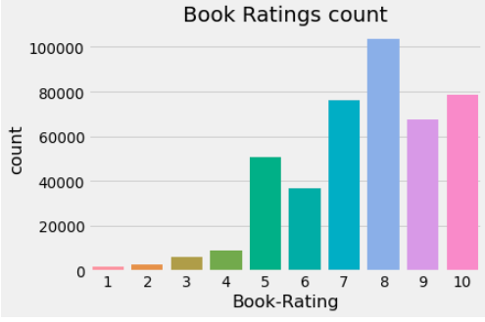
Analysis on: Book Rating Counts (Contd.)
Now we can see that in the ratings plot most of the books have been rated 8 out of 10
The number for 1 rating is lowest among all
Second highest ratings have received as 10 and 7 stars

Slide 11
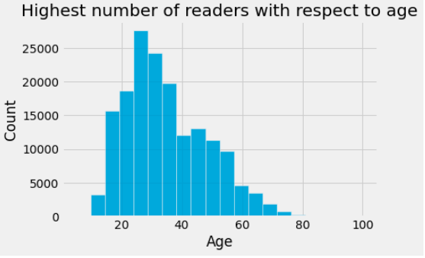
Analysis on: Highest Number of Readers w.r.t Age
Highest number of the readers lies in between the age group of 20 – 40
People having age of 20-30 are the highest readers exactly.

Slide 12
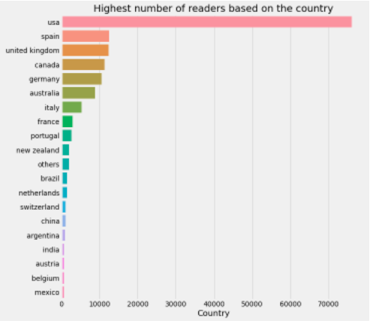
Analysis on: Country Representation in the dataset
Most customers are from the United States of America, followed by Canada, United Kingdom and Germany.
Countries with less than 1% customers are labeled as other

Slide 13
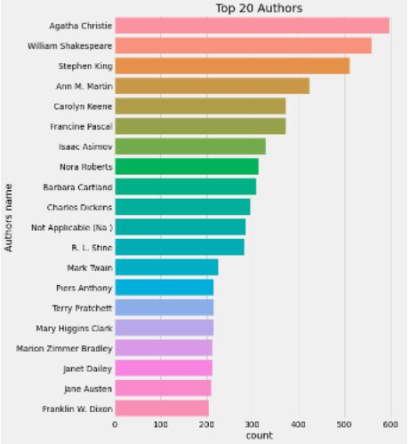
Analysis on: Top Authors
We can see that “Agatha Christie” is the best author who has written 632 books.
“William Shakespeare” is the second best author who has written 567 books

Slide 14
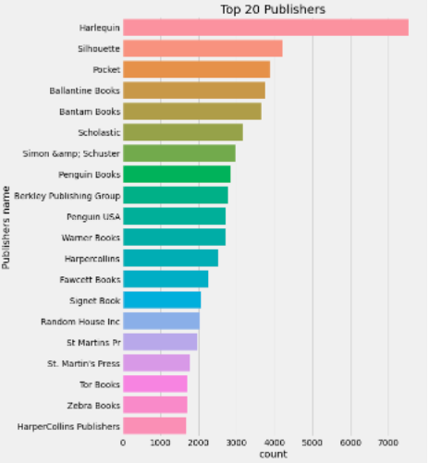
Analysis on: Top Publishers
We can see that “Harlequin” is the best publisher which has published 7,535 books.
“Silhouette” is the second best publisher which has published 4,220 books

Slide 15

Feature
Engineering

Slide 16
Handling Missing Values
Handled missing values in all the three datasets.
Imputing Values
Since, we have incorrect values in following features, so we need to impute them.
Outliers and Imputation
Treated outliers in all the three datasets

Slide 17

Recommendation System

Slide 18
Different Recommendation Systems Used:
Popularity Based Filtering: It basically uses the items which are in trend right now. For example, if any product which is usually bought by every new user then there are chances that it may suggest that item to the user who just signed up.
Collaborative Filtering: Collaborative filtering is a technique that can filter out items that a user might like on the basis of reactions by similar users.
It works by searching a large group of people and finding a smaller set of users with tastes similar to a particular user. It looks at the items they like and combines them to create a ranked list of suggestions.

Slide 19
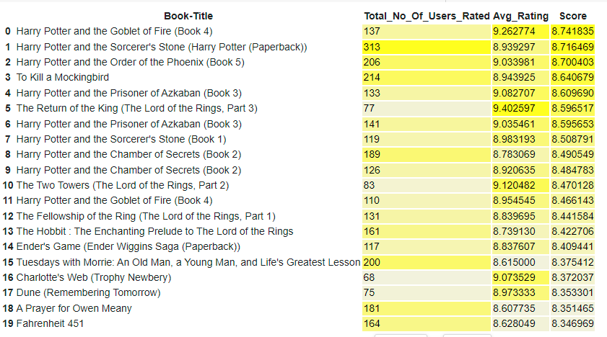
Popularity Based Recommender System:
The Popularity based recommender provide a general chart of recommended books to all the users. They are not sensitive to the interests and tastes of a particular user.

Slide 20
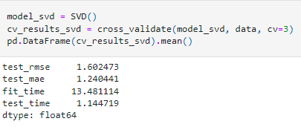
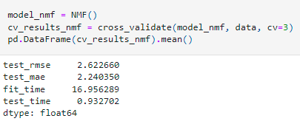
Collaborative Filtering (Memory Based Approach)
It's clear that for the given dataset much better results can be obtained with SVD approach - both in terms of accuracy and training / testing time.

Slide 21
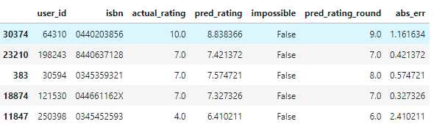
Collaborative Filtering (Memory Based Approach) - SVD Model Results
Distribution of actual and predicted ratings in the test set According to the distribution of actual ratings of books in the test set, the biggest part of users give positive scores - between 7 and 10. The mode equals 8 but count of ratings 7, 9, 10 is also noticeable. The distribution of predicted ratings in the test set is visibly different. One more time, 8 is a mode but scores 7, 9 and 10 are clearly less frequent. It shows that the recommender system is not perfect and it cannot reflect the real distribution of book ratings.

Slide 22
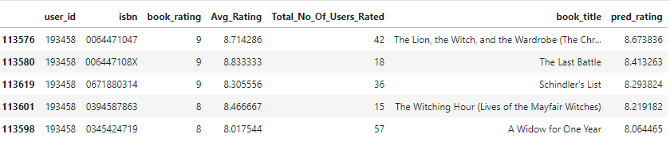
Collaborative Filtering (Memory Based Approach) - SVD Model Results
User-ID - 193458
Test set: predicted top rated books

Slide 23
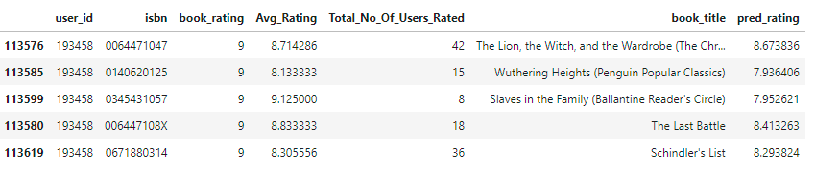
Collaborative Filtering (Memory Based Approach) - SVD Model Results
Test set: actual top rated books
For this part of the analysis, the user with id 193458 was selected. By analyzing book ratings by this user, it can be noted that he/she likes diverse types of readings: English romantic novels (Pride and Prejudice, Sense and Sensibility), fantasy (Narnia) as well as historical novels (Schindler's List). Among the recommended books there are other works from Narnia's series, two historical novels and one romance which correlates with user's previous preferences.

Slide 24
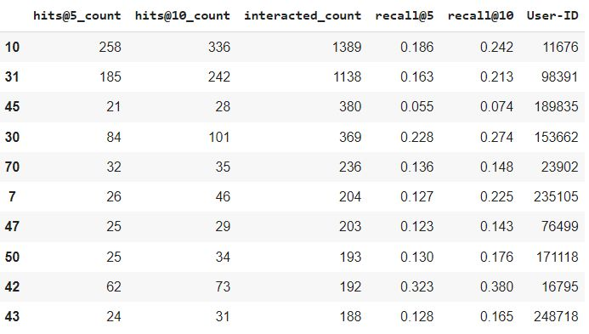
Collaborative Filtering (Model Based Approach)
It makes predictions about the interests of a user by collecting preferences from many users. The underlying assumption is, if a person A has the same opinion as a person B on a set of items, A is more likely to have B's opinion for a given item than that of a randomly chosen person.

Slide 25


Collaborative Filtering-(Item-Item based)
INPUT OUTPUT

Slide 26
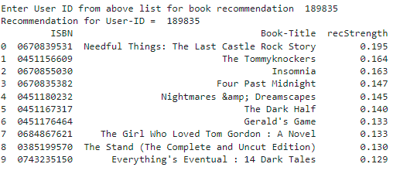
Collaborative Filtering-(User-Item based)

Slide 27
Conclusion
Majority of the readers were of the age bracket 20 - 40 and most of them came from North American and European countries namely USA, Canada, UK, Germany and Spain.
If we look at the ratings distribution, most of the books have high ratings with maximum books being rated 8. Ratings below 5 are few in number.
Author with the most books was Agatha Christie, William Shakespeare and Stephen King.
For modeling, it was observed that for model based collaborative filtering SVD technique worked way better than NMF with lower Mean Absolute Error (MAE).
Amongst the memory based approach, item-item CF performed better than user-user CF because of lower computation requirements .
It is very important to deal with implicit and explicit user ratings, separately.
For dealing with explicit ratings, we can build simple models based on ratings, and we can also use certain comprehensive models based on Collaborative Filtering approach.

Slide 28
Conclusion (Contd.)
For dealing with implicit ratings, we can build KNN based models , and we can also use content based models, which utilize the similarity of different contents, to make recommendations.
It is crucial to be precise about user preferences, otherwise repetitive recommendations can cause nuisance to the user.

Slide 29
Challenges
Handling of sparsity was a major challenge as well since the user interactions were not present for the majority of the books.
Understanding the metric for evaluation was a challenge as well.
Since the data consisted of text data, data cleaning was a major challenge in features like Location etc.
Decision making on missing value imputations and outlier treatment was quite challenging as well.

Slide 30


